Slide 1
Iteration 1
Team 4: Project Portal

Slide 2
Project Features
A web-based application
Main Features
Users actively developing and publishing new projects: Active projects can post preliminary results while opening discussions to address issues or ask experts for their opinions as the project progresses. Once projects are later in their development cycle they can utilize our platform to distribute results on a larger scale. Additionally they can seek collaborators for future work as new potential use cases and applications for the project emerge. Additionally, for more entry level coding projects, professors can use the Project Portal to consolidate and assess final projects/assignments in their courses.
Users interested in discovering existing projects and via the Portal's search functionality: Here users can search through all of our hosted projects to find the work that's relevant to their use case. This will leverage our manual and parsed keyword tagging to enable user search to work seamlessly regardless of the number of projects hosted on our site. Additionally users may be able to open issues and contact the project author in the future.

Slide 3
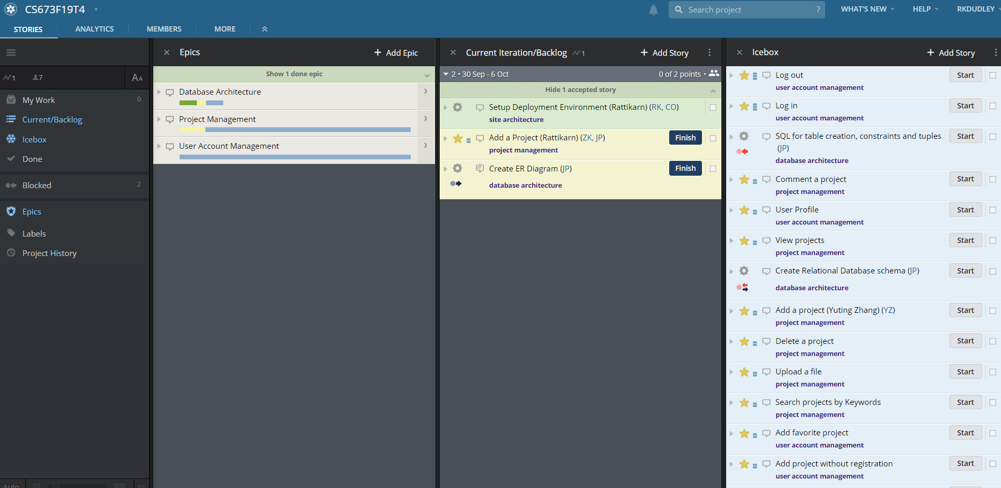
Pivotal Trackers for iteration 1

Slide 4
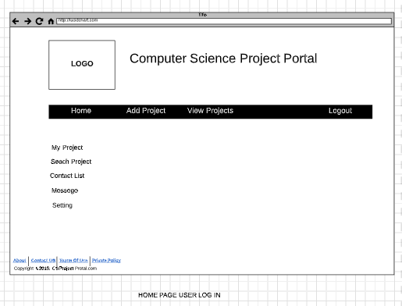
UI Mock Up Version 1

Slide 5
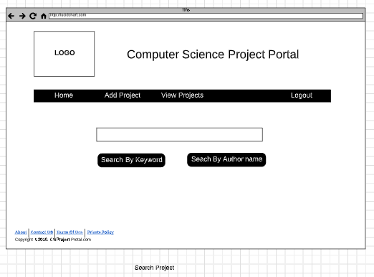

Slide 6
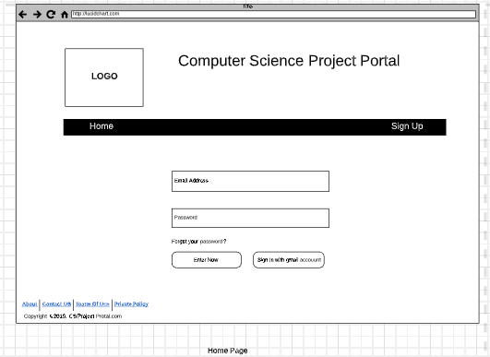

Slide 7
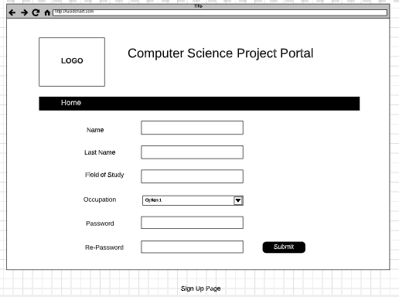

Slide 8
Client-Side
Language
HTML/CSS
Javascript , jQuery and C#
Framework
Bootstrap
AngularJS
Razor
Environment Setup
IDE is installed and set up.
Bootstrap and Javascript is integrated via a home page .
Skeleton homepage is set up.

Slide 9
Server-Side
Language
Asp.Net
Framework
RESTful API
Database:
MS SQL
Environment Setup
MS SQL and MS Visual Studio is installed and tested
Docker and Jenkins is installed for a deployment.
Database is in a progress.
Add function is in a progress.

Slide 10
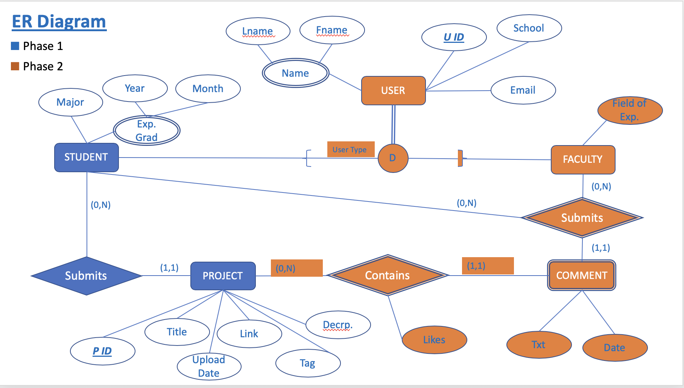
Database Architecture Design

Slide 11
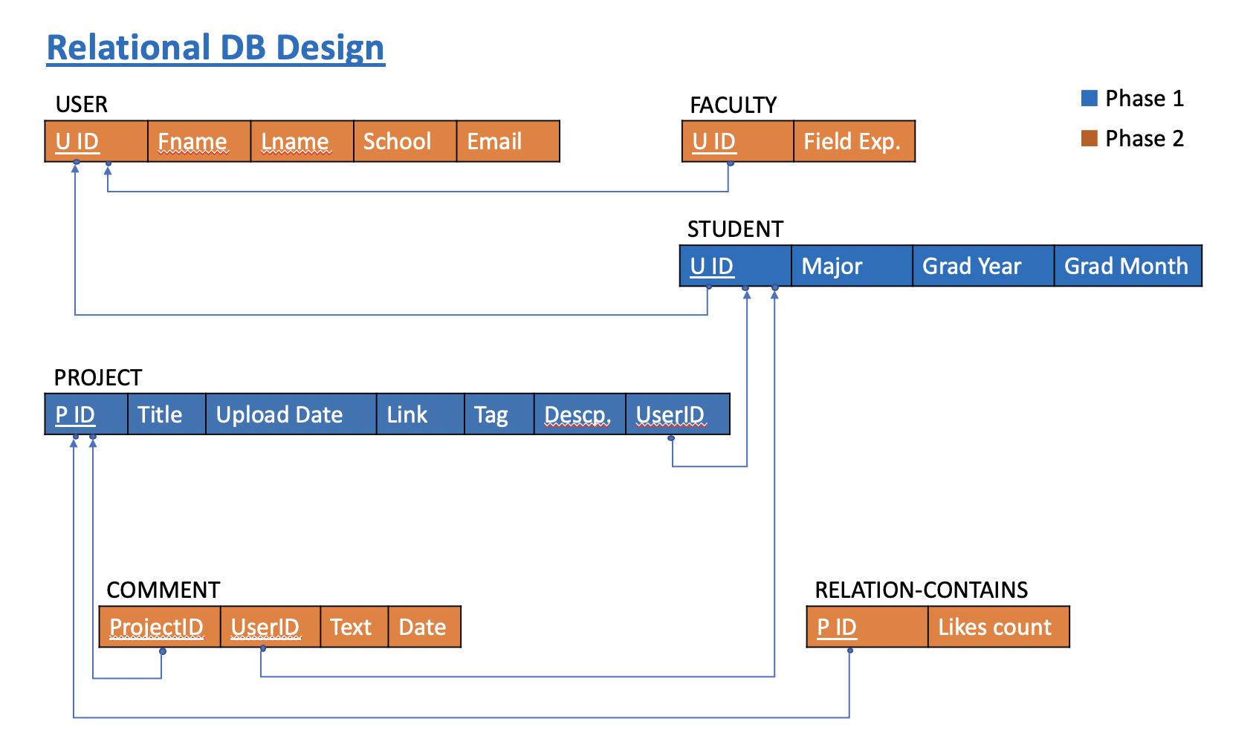
Relational Database

Slide 12
Thank you !

Slide 13
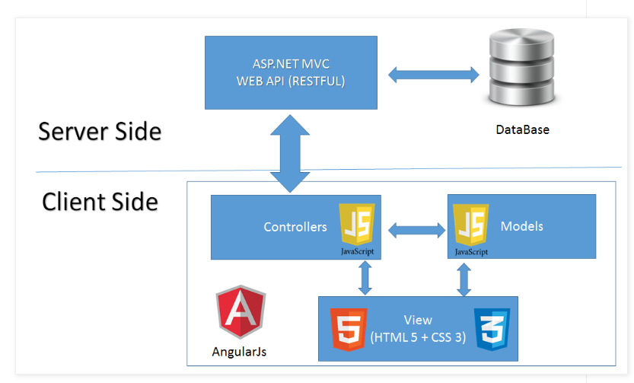
Global Architecture
Reference: http://oniwebblog.blogspot.com/2016/01/angularjs-create-web-site-using.html

